Slide 1
Masters of MongoDB
Lesson 18.1

Slide 2
Project Recap
Masters of MongoDB

Slide 3

Project Recap
Masters of MongoDB
Notes:
shutterstock_288649979

Slide 4

Masters of MongoDB
Notes:
shutterstock_1091816447

Slide 5
The Clear Positives
++ You stayed ambitious.
++ You made smart decisions feature-wise.
++ You demonstrated technical mastery.
++ You did a ton of learning on your own.
++ You closed out.
++ You dominated.
++ You didn’t make excuses even when you had them.
Masters of MongoDB

Slide 6
Advice For Next Time
01
Always start with guns blazing. The first 30 seconds always count. Always come ready to impress. Show a demo. Say something interesting.
02
Practice, practice, practice. The difference between good speakers and weak ones is in the execution of minor details. Don’t get lost in transitions. Don’t get lost looking for your code.
03
Don’t be afraid to take charge. Learn to be confident by default. Chime in when you can. Look for ways to lead in the groups you find yourself in.
Masters of MongoDB

Slide 7
Next Steps
01
GIF your GitHub readme. Back-end projects like the ones you completed are harder to “see” for a recruiter. Throw in a GIF that flips through all the screens of your project. There are plenty of ways to record a video and convert it to GIF. This will look really impressive.
02
Create a guest login. Have a “dummy” guest login to enter your application. Make it easily apparent on your readme.
03
Write a tutorial. Pitch a tutorial to scotch.io if you used any unusual libraries. You will get $$$ and build credibility.
Masters of MongoDB

Slide 8
Next Steps
04
List your niche skills on LinkedIn. All of you should be listing Node, Express, SQL, data visualization, etc. on your Linkedin profile.
05
List your project on LinkedIn. If you don’t have a lot of tech experience on LinkedIn, milk the project you created for all its worth—especially if it is really good.
06
Consider writing recommendations for each other. I will remind you about this later as well—consider writing recommendations for your group members and peers. Right now you are all students, but you won’t be for long. Spread the credit!
Masters of MongoDB

Slide 9
The Road Ahead
Masters of MongoDB

Slide 10

The Road Ahead: Your Final Journey
MongoDB
React
Computer Science Fundamentals:
Algorithms
Big O Notation
Data Structures
Masters of MongoDB

Slide 11
Double Down
It’s time to double down and make sure you have a strong foundation.
You have access to me and the TAs for two months.
Look through the code base. Identify your weaknesses.
Schedule a help session during office hours.
And put in the hard hours!
This is the absolute best time to learn this material.
Masters of MongoDB

Slide 12

Start Now. Don't Procrastinate.
Masters of MongoDB
Notes:
shutterstock_396344455

Slide 13
Your Goals: Beginning of the Year
“To land a solid career and be able to support my family.”
“Hope to make something of myself one day.”
“An opportunity to be more creative in my day-to-day work.”
“To get a better paying job.”
“I want nothing more in the entire world than to be a game designer.”
“Change careers and become a web developer.”
“To build mastery. To learn a skill that I haven’t yet explored.”
“To create a chapter better than the last.”
Masters of MongoDB

Slide 14
For Reference:
Students who do well in our part-time classes tend to put in an average of 20 hours a week for homework and self-study.
Masters of MongoDB

Slide 15
MongoDB
Masters of MongoDB

Slide 16
What’s MongoDB?
MongoDB is a very popular noSQL database.
It uses a document-oriented model as opposed to a table-based relational model (SQL).
MongoDB stores data in BSON format (effectively, compressed JSONs).
MongoDB has tons of drivers and packages for connecting to Node, C++, Java, etc.
Masters of MongoDB

Slide 17

Relational Databases (SQL)
ID | Title | Author | Published
1 | The History of Blah | Blah Matic | 2010
2 | The Chronicles of Blahrnia | Sir Blahston | 2011
3 | Love in the Time of Blah | Gabriel Garcia Blah | 2013
SQL relies on joins to combine relevant data.
Author | Email | Phone Number
Blah Matic | blahston@gmail.com | 911-546-5454
Sir Blahston | blahby@gmail.com | 911-544-5112
Gabriel Garcia Blah | blahby231@gmail.com | 125-215-5645
Masters of MongoDB

Slide 18

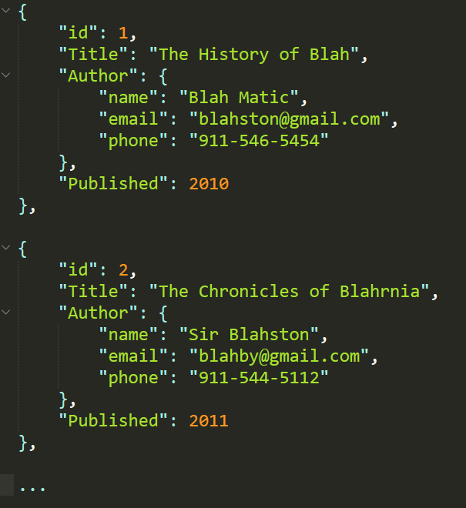
Document Database (noSQL)
noSQL databases, on the other hand, are effectively JSONs.
They excel at heterogeneous data formats and are easy to implement.
Masters of MongoDB

Slide 19
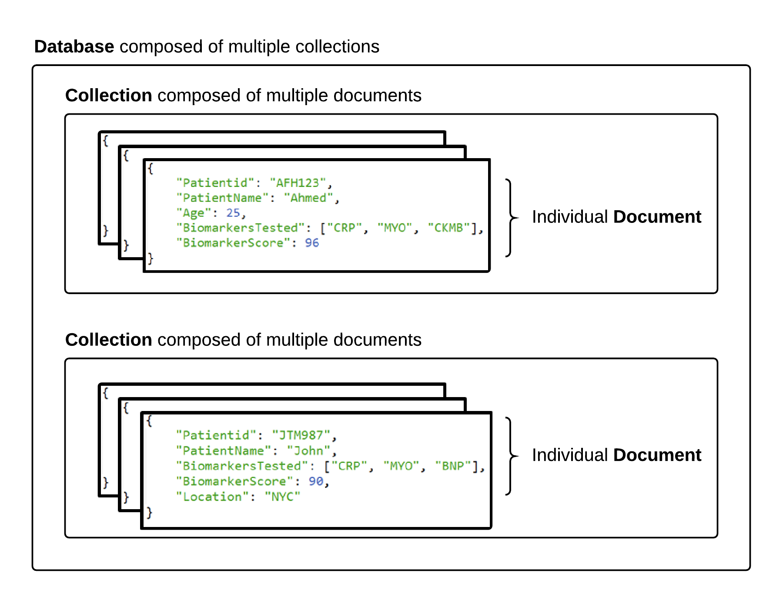
MongoDB Storage
Masters of MongoDB

Slide 20
MongoDB Storage
Terms are slightly different in the noSQL context. Take note!
SQL Term | noSQL Term
Database | Database
Table | Collection
Row | Document
Column | Field
Masters of MongoDB

Slide 21
Partner Activity:
Questions & Answers
10 minutes
Masters of MongoDB

Slide 22
Partner Activity: Questions & Answers
Suggested Time: 10 minutes
Work with your neighbors to research the following:
01
What are the advantages of using a noSQL database like MongoDB according to the MongoDB website?
02
What are the advantages of using a noSQL database like MongoDB according to the web (according to places like Quora)?
03
What are the disadvantages of using a noSQL database like MongoDB according to the web (according to places like Quora)?
Masters of MongoDB

Slide 23

Learn to See Through the Nonsense
The tech world is filled with it.
Masters of MongoDB
Notes:
shutterstock_456057580

